Slide 1
Residential Housing Analysis for Bay Area

Slide 2
Objective
Analyze the current real estate listings data for Bay area counties
Understand the current housing market dynamics to answer questions as
Most listed real estate class in Bay area*
Can most households affords those listings based on current financial situation
Cities where real estate listings are showing downward financial trend
*Santa Clara County, San Mateo County, Alameda County, Contra Costa County, Marin County, Napa County, San Francisco County, Solano County and Sonoma County

Slide 3
Approach
Source
zip code data from government website (https://www.unitedstateszipcodes.org/zip-code-database/)
Property listings data from realtor.com (approx 900 listings with 500+ in cities of interest)
Household data from government census data website*
Load
Zipcode - manual one time download
Property Listings - scrape the realtor.com for the properties listed for zip codes in the counties of Bay area
Income Data - Government census data website.
Process
Remove the listings where the information is corrupt based on the json parsing.
Consider the median household income only for analysis.
Analyze on top 20 cities based on the number of listings we could get
*https://data.census.gov/table/ACSST5Y2022.S1901?t=Income%20(Households,%20Families,%20Individuals)&g=040XX00US06$8600000&moe=true

Slide 4
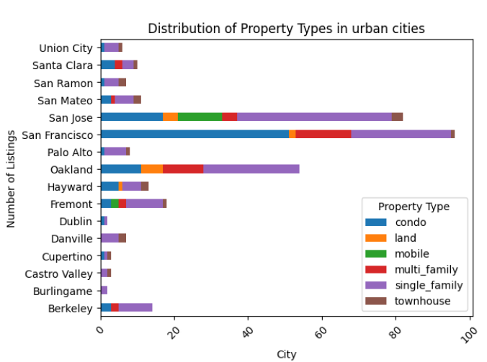
Distribution Of Property Types In Top 20 Cities of Bay Area
Work:
Used matplotlib.pyplot for better visualization
Grouping the data by city and property type and plot barh chart
Analysis💡:
In San Francisco, almost 50% of the property type is condo & 30% is single family home
In San Jose, around 40% are single family & 20% are condo properties
Almost every other city has approximately higher percentage of single-family homes as property type

Slide 5
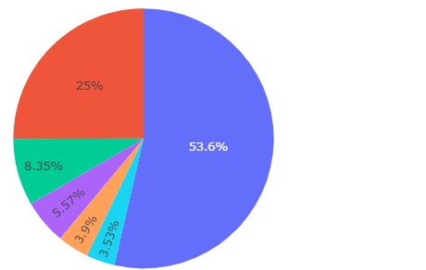

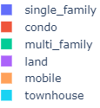

Most Popular Home Type In Bay Area
Work:
Value count on home type column and plot pie chart
Analysis💡:
Single family is the most popular home type in the Bay Area with 53.6%
Around 80% of the properties listed on the market are single family and condos together
Which reinforces for the fact that the current market needs are categorizing to more nuclear families in the top 20 cities based on the listing count of the data.

Slide 6
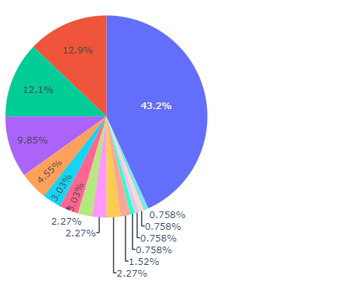
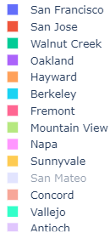
City Wise Property Distribution For Condos
Work:
Investigate the condos distribution and understand the price ranges and cities
Analysis💡:
As we can notice San Francisco itself have 43% of the condos listed in bay area along with San Jose and Walnut Creek which makes it around 65% of condos listed for sale

Slide 7
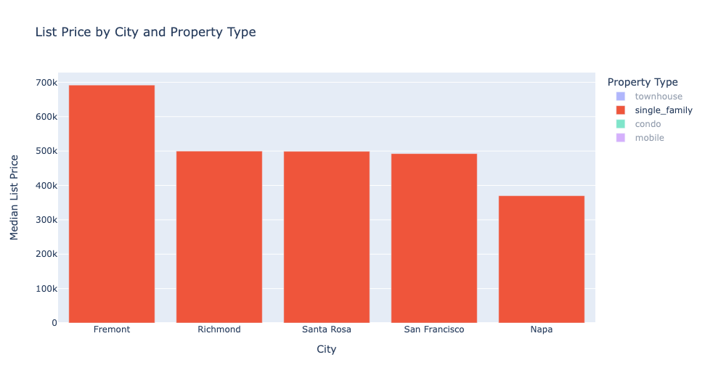
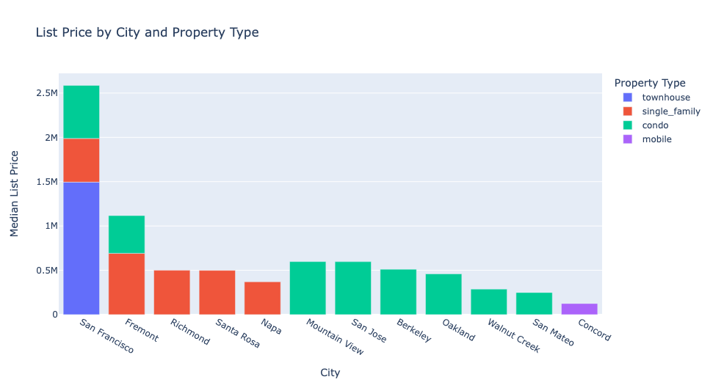
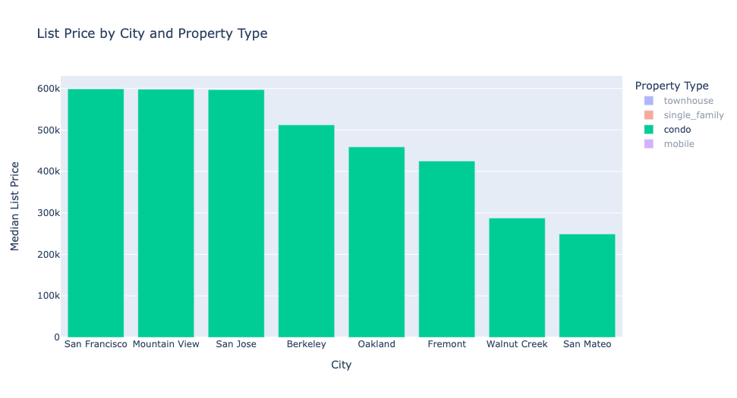
Listing Prices for 1 Bed Homes
SF, Mountain View, San Jose: Condo median price: $600K for 1 bed.
SF Listings: Not enough data on 1 bed townhouses
Fremont Median Prices: 1 bed Single family is $650K and condos: $425K
SF, Fremont, Affordability: Costly requiring significant investment

Slide 8
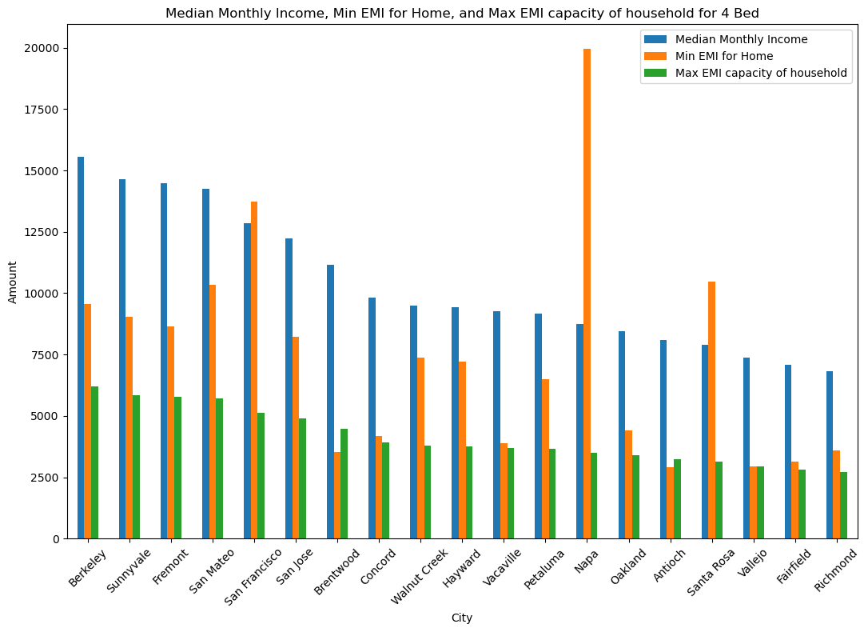
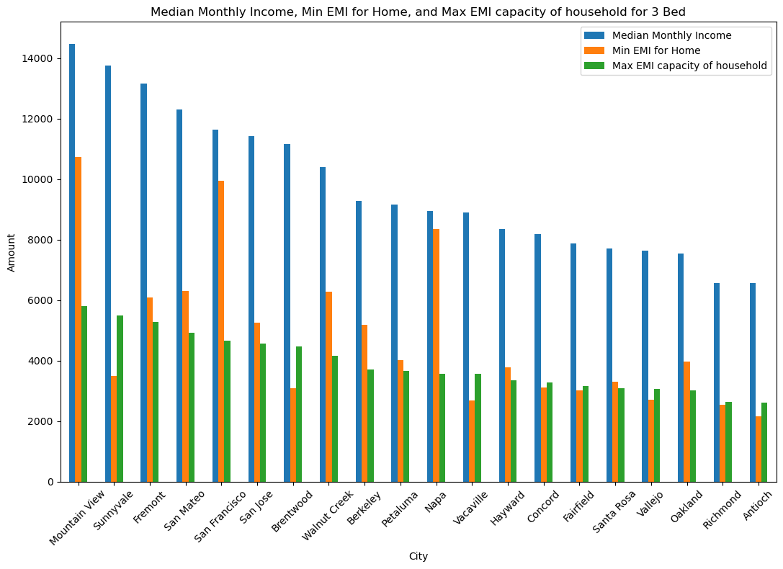
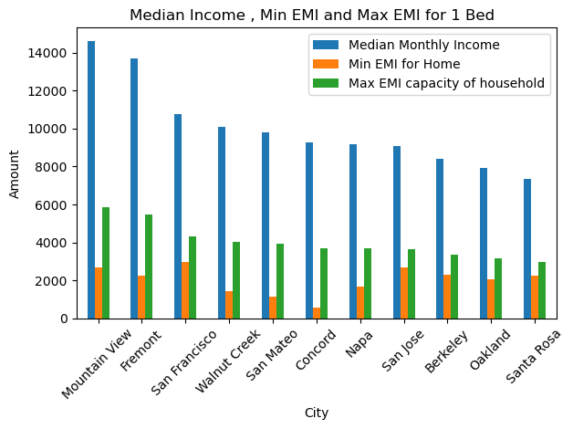
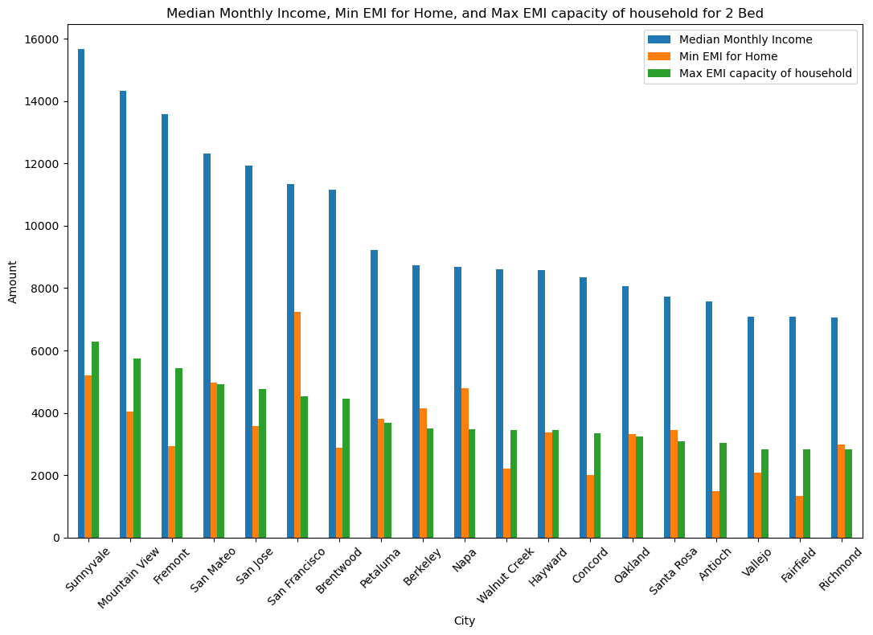
Affordability of Housing in Bay Area Cities
1 Bed : Most Bay area cities affordable due to high median income
2 Beds : Still affordable with SF, Berkeley, Napa being exceptions
3 Beds: Still accessible for those further from the bay area
4 Beds: Exclusive to HNI’s, ultra rich with Brentwood still an exception

Slide 9
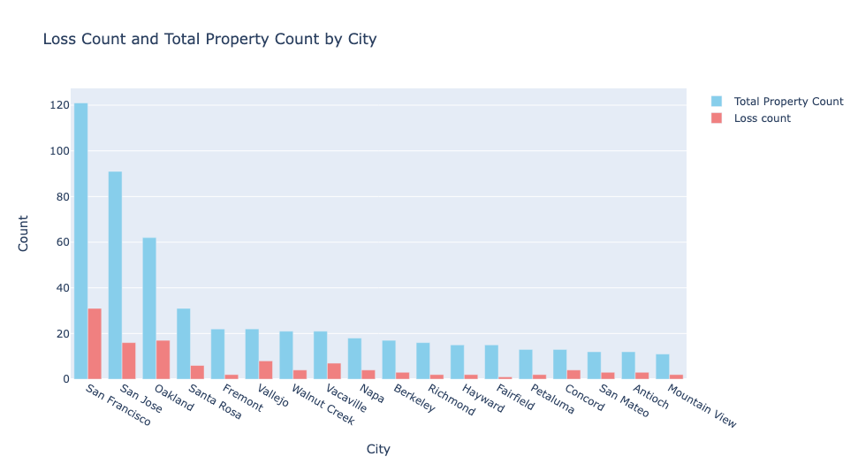
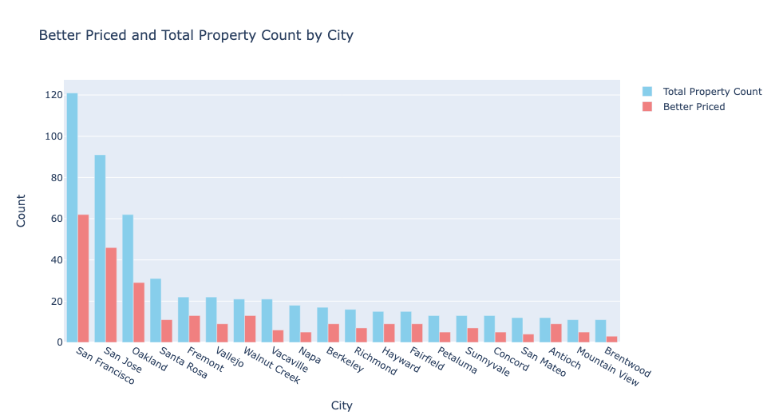
Properties Listed at Discounts
San Francisco: Over 40 listings below previous sale prices, indicating motivated sellers or market corrections.
San Jose: Nearly 30 listings at a loss compared to prior sales, suggesting pricing adjustments to match market dynamics.
Other Cities (e.g., Oakland, Fremont, Walnut Creek): Notable counts of discounted listings.
Berkeley, Richmond, Hayward, Pittsburg: Few or no properties listed below prior sale prices.
Prevalence of listings at loss values varies across Bay Area cities, with major hubs like San Francisco and San Jose offering more opportunities for discounted properties

Slide 10
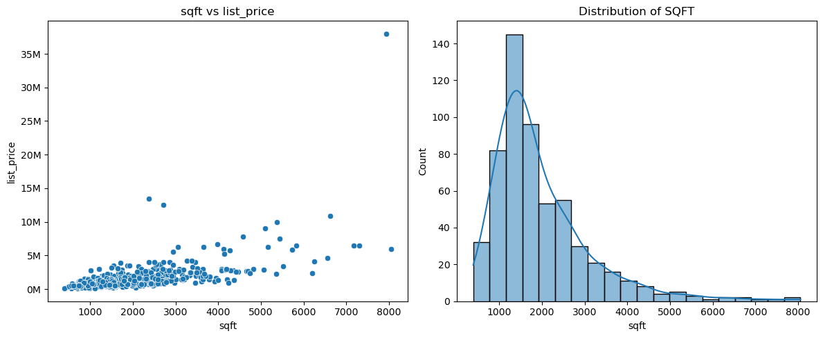
SQFT vs Price & Distribution of SQFT in Listings
The scatter plot shows the overall listing price vs sqft distribution. Sqft and list price shows linear correlation
Almost 90% of the properties are less than 3000 sqft.
Most of the listed properties are 1500-2000 sqft; shows single family or condo listing concentration

Slide 11
Summary
Good Deals
High-Priced Properties
Unsustainable to Own
Available in major hustling cities like San Francisco, San Jose, Oakland, & Santa Rosa
Cities like Fremont, Hayward, Fairfield, Walnut Creek
Almost all the Bay Area
prominent cities with a few exceptions of Brentwood, Concord, Vacaville, Antioch, and Vallejo

Slide 12
Summary
Price Affordability
Recommendation
Market catering to the needs by listing single family homes & condos with ~80% of the total listings
Cities such as Fremont with its close proximity to major hubs and high median household income

Slide 13

Thank you!

